Slide 1
ELECTRICITY
CHAPTER NUMBER 12
Notes:
Welcome to the to the lecture on Electricity

Slide 2
What is covered in this chapter
Electric current and circuit
Electric potential and potential difference
Notes:
The topics covered in this chapter are are:
Electric current and circuit
Electric potential and potential difference

Slide 3
Electric current and circuit
Electron
Current
Circuit
Electric current
Notes:
Lets start by understanding about Electron Current Circuit and Electric current
Electrons: they constitute of flow of charges
Current: when electric charges flow through a conductor we say there is electric current in a circuit
Circuit: A continuous and closed path for the flow of electric current is an electric circuit.
Electric current: rate of flow of electrons electric charges
Conventionally, in an electric circuit the
direction of electric current is taken as opposite to the direction of the
flow of electrons, which are negative charges.

Slide 4
Current is given by I and by formula :
I=Q/t
Notes:
If a net charge Q, flows across any cross-section of a conductor in time t, then the current I, through the cross-section is
I=Q/t
The SI unit of electric charge is coulomb (C), which is equivalent to the charge contained in nearly 6 *10^18 electrons.
Electric current’s Unit: Ampere (A)
One ampere: the flow of one coulomb of charge per second

Slide 5
Electric Circuit
Notes:
Diagram of a typical electric circuit comprising of a bulb key, battery , ammeter and a key and what happens inside an electric circuit.

Slide 6
Electric Potential and potential difference
What makes the electric charges flow in a circuit?
Notes:
As we have observed the flow of water in a pipe will require gravity, similarly the flow of electric charges in a conductor will need some pressure ,this pressure is generated by creating a potential difference. Potential difference can be created by applying a battery which consists of 2 or more cells.

Slide 7
Potential difference:
Explanation for potential difference
When a battery consisting of several cells goes through a chemical reaction due to the chemicals inside of it, a potential difference is set at the terminal of this battery, hence when a circuit is put electric charges start flowing.
Definition of potential difference
difference between two points in an electric circuit carrying some current as the work done to move some unit charge from one point to another
Notes:
When a battery consisting of several cells goes through a chemical reaction due to the chemicals inside of it, a potential difference is set at the terminal of this battery, hence when a circuit is put electric charges start flowing.
Moving on to the definition of potential difference
Definition : difference between two points in an electric circuit carrying some current as the work done to move some unit charge from one point to another

Slide 8
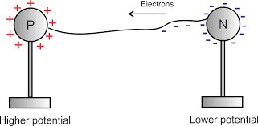
Potential difference
Notes:
Electric circuits. Potential energy. Imagine trying to move a negative charge from the positive end of the battery along the wire to the negative end. This implies moving the negative charge against a constant opposing force in its entire journey.

Slide 9
Formulae:
V=w/Q
W=work done
Q=charge
The SI unit of electric potential difference is volt (V), named after Alessandro Volta (1745–1827), an Italian physicist.
Therefore,
1 volt =1 joule/1 coulomb
1 V = 1/ J C–1
Potential difference is measured by using VOLTMENTERE
Notes:
Potential difference (V) between two points = Work done (W)/Charge (Q)
The SI unit of electric potential difference is volt (V), named after Alessandro Volta (1745–1827), an Italian physicist.
Therefore,
1 volt =1 joule/1 coulomb
1 V = 1/ J C–1
Potential difference is measured by using VOLTMENTERE

Slide 10
Circuit Diagram
It is often convenient to draw a schematic diagram, in which different components of the circuit are represented by the symbols conveniently used.
The table shows us the different used conventional symbols in a typical circuit
Notes:
Lets see the components that consists of a circuit
It is often convenient to draw a schematic diagram, in which different components of the circuit are represented by the symbols conveniently used.
The table in next slide shows us the different used conventional symbols in a typical circuit

Slide 11
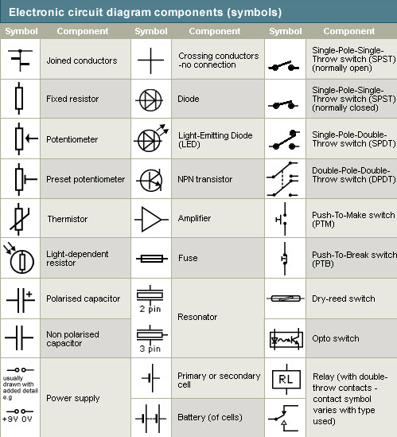
Notes:
Lets learn the components and their meanings
Now I ask you to go through the electric circuit Components and what they stand for from the slide.
(Point at each symbol and say there name written adjacently )

